Slide 1

Welcome!
Early Childhood Inclusion Policy Summit Pre-Learning Webinar
Website for additional information on summit:
www.eclre.org/good-to-know/illinois-early-childhood-inclusion-policy-summit.aspx
Audio will play through your computer speakers- you can use the Audio wizard under the Meeting Dropdown menu at the top to test your audio
You can download handouts from the File pod in lower left corner.
Notes:
Welcome-
We are so glad you could join us- we will be recording the webinar today so we will post a link on the Summit page of Eclre.org

Slide 2
Presenters
Erin E. Barton, PhD, BCBA-D
Assistant Professor Department of Special Education, Vanderbilt University
Ann Kremer, MSEd
Project Director
Early CHOICES
The Early Childhood Inclusion Policy Summit is sponsored by the Early Learning Council, Illinois Council on Developmental Disabilities, Governor’s Office of Early Childhood Development and the Illinois Interagency Council on Early Intervention. The Summit is funded by the Illinois Council on Developmental Disabilities and coordinated by Early CHOICES.

Slide 3

Policy Statement
Notes:
In September 2015 US DHHS and DOE issued this joint policy statement on Inclusion of Children with Disabilities in EC Programs–
Our national departments of Ed and HHS have set the course for us and recently
DOE OSEP Issued the DCL on January 9, 2017 to reaffirm the position of the Department that all young children with disabilities should have access to inclusive high-quality early childhood programs where they are provided with individualized and appropriate supports to enable them to meet high expectations
Early CHOICES specifically is the funded through ISBE IDEA discretionary funds to promote increasing high quality inclusive education for each and every preschool aged child.
We have been working with Excelerate IL and our Quality Rating and Improvement system to develop the Award of Excellence for Inclusion of children with special needs.
We have great work in place from this to help us define high quality inclusion and implement for young children. But we found that our little project and the many other efforts that are happening in early intervention, in Head Start in our child care system were each addressing the challenges from our unique perspective.
How could we bring together all these various systems and efforts to improve access to high quality inclusion?

Slide 4


State Recommendations
Create a State-Level Interagency Task Force and Plan for Inclusion
Ensure State Policies Support High-Quality Inclusion
Set Goals and Track Data
Review and Modify Resource Allocations
Ensure Quality Rating Frameworks are Inclusive
Strengthen Accountability and Build Incentive Structures.
Build a Coordinated Early Childhood Professional Development (PD) System
Implement Statewide Supports for Children’s Social-Emotional and Behavioral Health
Raise Public Awareness

Slide 5
Proposal to Illinois Council for Developmental Disabilities
Illinois will have a vision statement and agreement to use the vision and guidelines by key stakeholders in Illinois to implement policy/practice changes aligned with the DOE & HHS recommendations to states on inclusion of children with disabilities in early childhood programs. As a result of stakeholder engagement awareness of best practices in inclusion will be increased and inclusion will be prioritized when considering future Illinois policy and program design.
Notes:
We wrote the proposal to host the summit-- this was our goal-
We know that these interventions will support all kids – and support the field to be better informed and skilled to serve all our children

Slide 6
Total Number of Children in Illinois

Slide 7
Illinois Young Children with IFSP or IEPs
Total number of children with IFSPs*
  20,668
Total number of children with IEPs**
  37,878
*IDHS FFY 2015 Part C State Performance Plan
* *ISBE FFY 2015 Part B State Performance Plan
Notes:
We don’t know who has not been identified – there are children with needs who are not eligible under the guidelines- so chronic medical issues, etc. These numbers will likely increase….

Slide 8
Early Childhood Programs Required to Prioritize or Enroll Children with Disabilities
  Head Start and Early Head Start: At least 10% of children must have IFSPs and IEPS
  Early Head Start/Child Care Partnerships: At least 10% of children must have IFSPs and IEPs
  Preschool Expansion Grant: Children with IEPs are a priority population. They must also meet the expansion grant requirements. Federal expansion grant requires the program to serve children with disabilities.
  Preschool for All and Prevention Initiative: Children with concerns based on developmental screening prioritized for enrollment
  Home Visiting: Children with disabilities prioritized for enrollment
  Child Care: Children with disabilities prioritized for enrollment

Slide 9
Children Enrolled
* Approximate, based on CCAP enrollment over all of 124,245
  Approximately 65%-70% are aged birth to 5
  No data on number of children with IEPs and IFSPs in childcare
Notes:
Sources-
PFA: ISBE
PI: ISBE report
HS- 2015 IL HS Fact Sheet
Childcare Nov FY17 CCAP

Slide 10
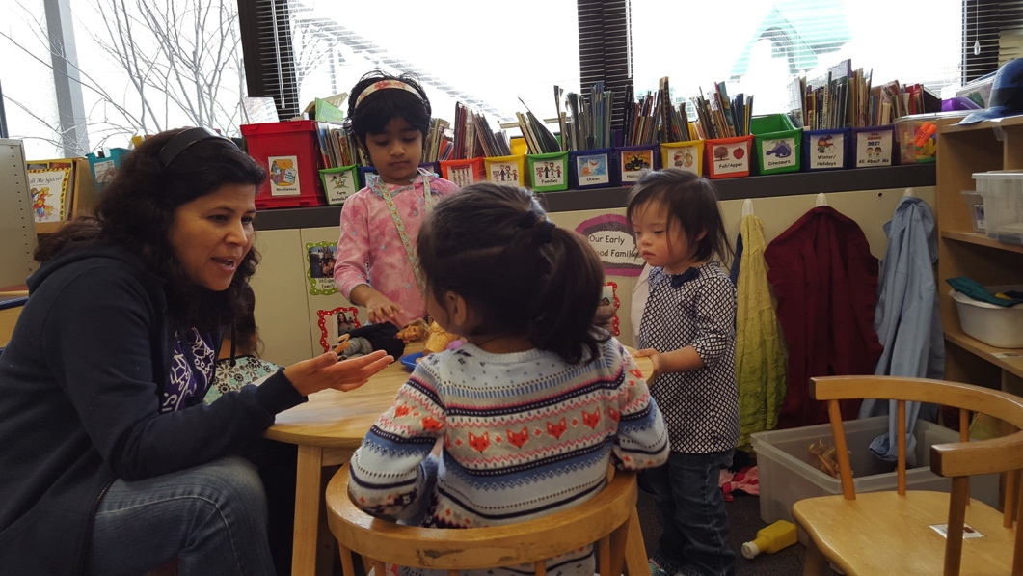
Programs and Summary
Increasing the enrollment across programs
Illinois has been prioritizing high needs children
So where do young children with IEPs and IFSPs receive their services?
Notes:
Good news- we keep increasing the number of overall spaces for children birth -5
Even better news- IL has been prioritizing

Slide 11
Part B Indicator 6 Data
Where are children 3-5 with IEPs receiving the majority of special education services
Percent of children who attend a regular early childhood program and receive the majority of special education and related services in the program (Indicator 6a)
  National data- 45% Illinois data 38%
Percent of children who attend a special education classroom, separate school or residential facility (Indicator 6b)
  National data- 25% Illinois data 28%
Notes:
Early childhood educational environments data provides information on where young children with disabilities receive services. These data are related to access to inclusive settings and showcase whether children receive services within a regular early childhood program, including Head Start, Childcare, school programs, etc. (Maybe comment on national data and enormous variability across states)
From the published 2015-16 static tables (618 data)
6a 44.84 so 45
6b 25
Last year rounded up it was 44 and 26. Moving slowly!
IL 35.41%
IL 29%

Slide 12
Part B Indicator 6 Data
Where are children 3-5 with IEPs receiving the majority of special education services
Notes:
Same info in a graph

Slide 13
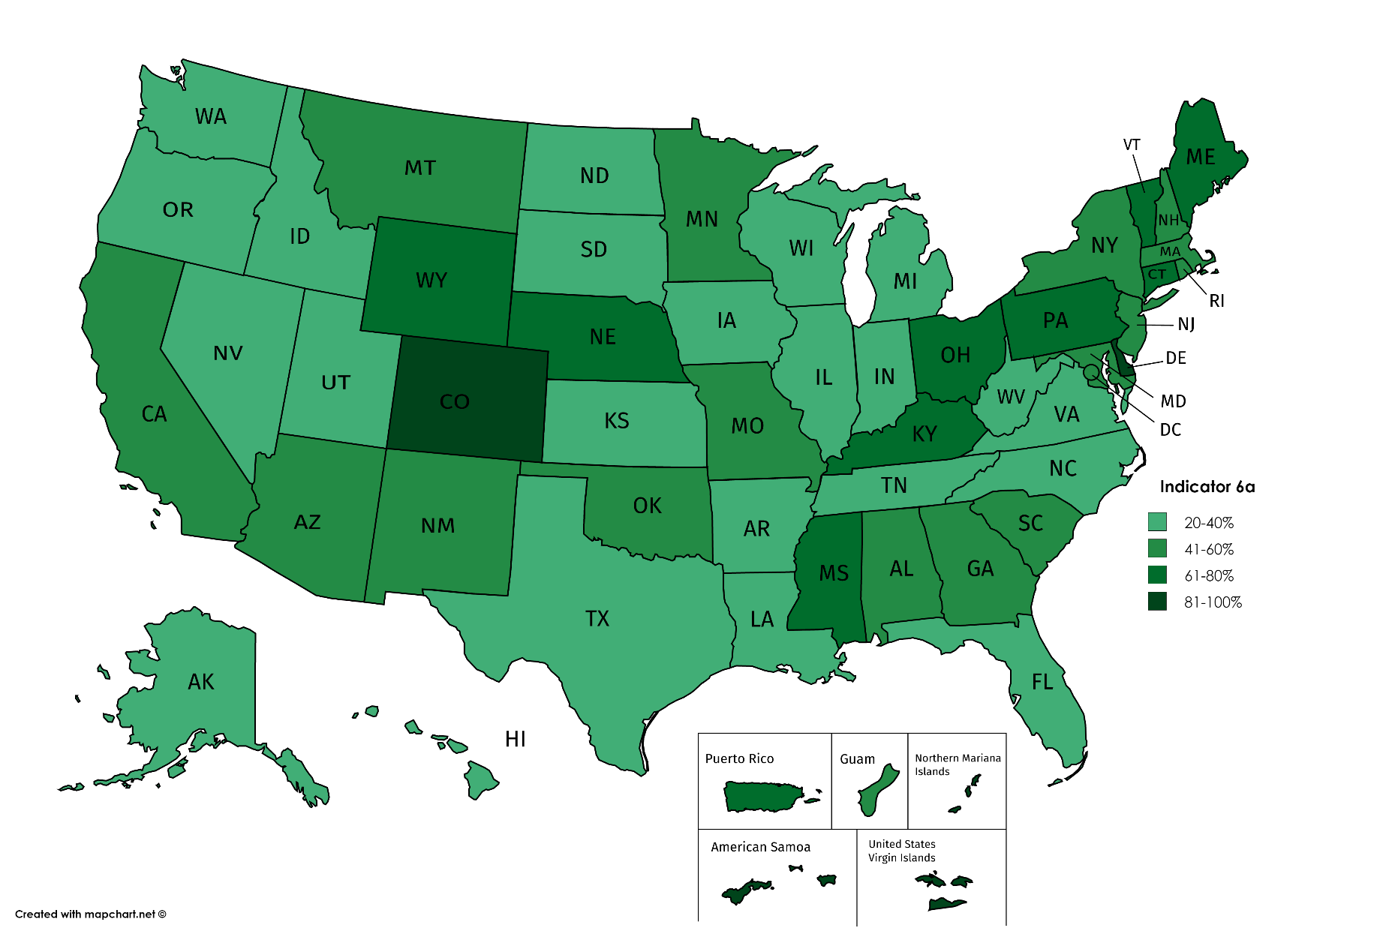
Indicator 6a https://www2.ed.gov/fund/data/report/idea/partbspap/allyears.html
20-40%
41-60%
61-80%
81-100%
Notes:
SPP/APR Link to Reports - https://www2.ed.gov/fund/data/report/idea/partbspap/allyears.html
IL is at lightest green at 38 %-- we want to higher here to include more childnen
Share educational environments data across states
Christy
Early childhood educational environments data provides information on where young children with disabilities receive services. These data are related to access to inclusive settings and showcase whether children receive services within a regular early childhood program, including Head Start, Childcare, school programs, etc. (Maybe comment on national data and enormous variability across states)
This map shows how each State is reporting data on children in special classrooms, separate school or residential facility. As you can see the data varies across the country.
Its one thing to have services in the classroom to inform us about participation of children with disabilities, but the data we want to know more about is the evidence based practices that help support their participation in typical settings.

Slide 14
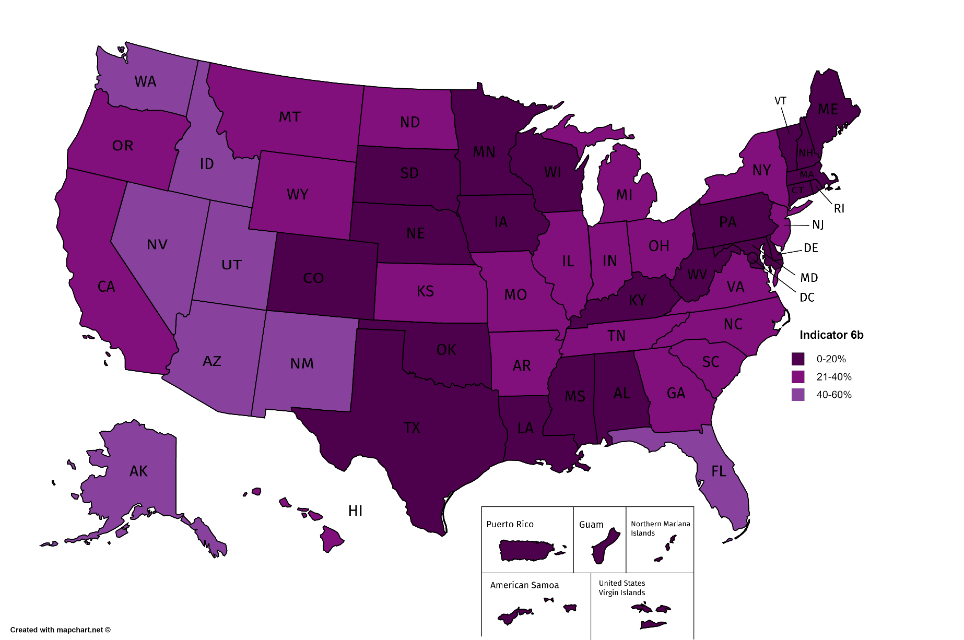
Indicator 6b https://www2.ed.gov/fund/data/report/idea/partbspap/allyears.html
0-20%
21-40%
40-60%
Notes:
SPP/APR for Part B for each state can be found at: https://www2.ed.gov/fund/data/report/idea/partbspap/allyears.html
Il is in middle purple at 28- we want to be lower in this category.
This map shows how each State is reporting data on children in special classrooms, separate school or residential facility. As you can see the data varies across the country.
Its one thing to have services in the classroom to inform us about participation of children with disabilities, but the data we want to know more about is the evidence based practices that help support their participation in typical settings.
.

Slide 15
Illinois Part C Indicator 2: Services in Natural Environments
Notes:
Total number of children with IFSPs*
20,668
Natural environments is different for 0-3 year olds

Slide 16
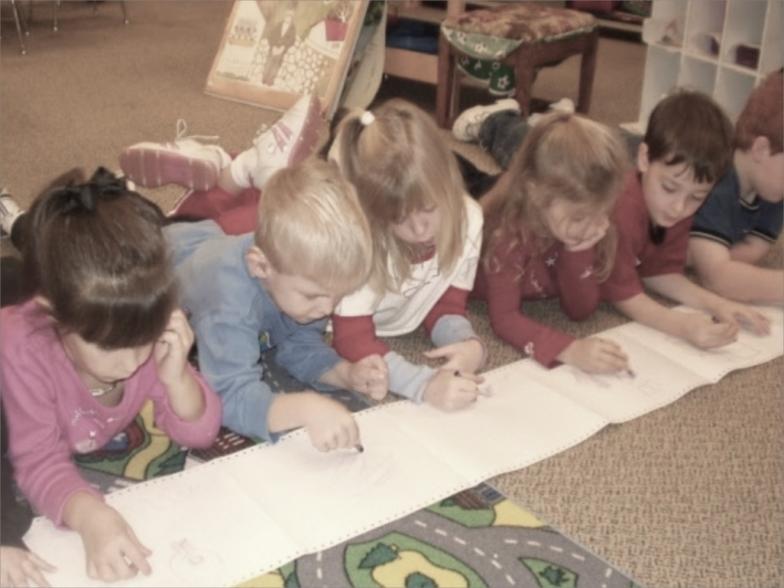
Early Childhood Inclusion:
The Research FACTS
Inclusion benefits children with and without disabilities and their families
Children with disabilities can be effectively educated in inclusive programs using specialized instruction
Individualized instruction can be used to teach a variety of skills in inclusive settings
Children with disabilities do not need to be “ready” to be included

Slide 17
Early Childhood Inclusion:
The Research FACTS
Families of children with and without disabilities generally have positive views of inclusion
Inclusion is not more expensive

Slide 18
Early Childhood Inclusion:
The Research FACTS
Successful inclusion requires intentional and effective collaboration and teaming
High quality inclusive programs = high quality early childhood program

Slide 19
Early Childhood Inclusion:
The IDEA FACTS
§ 300.114 LRE requirements. (ii) Special classes, separate schooling, or other removal of children with disabilities from the regular educational environment occurs only if the nature or severity of the disability is such that education in regular classes with the use of supplementary aids and services cannot be achieved satisfactorily.
§ 300.42 Supplementary aids and services. Supplementary aids and services means aids, services, and other supports that are provided in regular education classes, other education-related settings, and in extracurricular and nonacademic settings, to enable children with disabilities to be educated with nondisabled children to the maximum extent appropriate
§ 300.119 Technical assistance and training activities. Each SEA must carry out activities to ensure that teachers and administrators in all public agencies—
  (a) Are fully informed about their responsibilities for implementing § 300.114; and
  (b) Are provided with technical assistance and training necessary to assist them in this effort.

Slide 20




Federal Policy Statement
Inclusion of Children with Disabilities in Early Childhood Programs
www.ed.gov/early-learning
www.acf.hhs.gov/programs/ecd
Notes:
Inclusion is a shared responsibility and a top priority

Slide 21

Policy Statement on Inclusion of Children with Disabilities in Early Childhood Programs
The importance of early childhood inclusion
The need to focus on inclusion in early childhood
Sets expectations
Outlines research
Provides recommendations
Definition:
A “high-quality” early childhood program is one that is inclusive of children with disabilities and their families and ensures that policies, funding, and practices enable their full participation and success
Notes:
Speaker: Christy Kavulic
Notes:

Slide 22

Early Childhood Inclusion:
The IDEA FACTS
“ We are writing to reaffirm the position of the U.S. Department of Education (ED or Department) that all young children with disabilities should have access to inclusive high-quality early childhood programs where they are provided with individualized and appropriate supports to enable them to meet high expectations.”

Slide 23
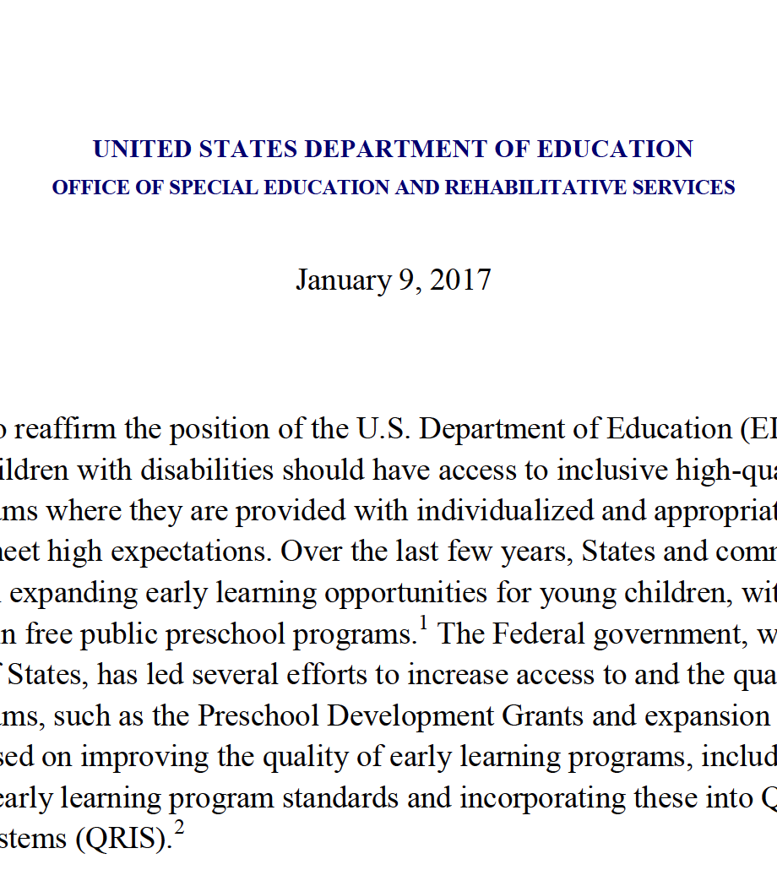
Early Childhood Inclusion:
The IDEA FACTS
Reaffirmed LRE for all children
FAPE must be provided in LRE regardless of whether the LEA has public preschool options.
The first placement option considered is the regular public preschool program.
Notes:
IDEA presumes that the first placement option considered for a preschool child with a disability is the regular public preschool program the child would attend if the child did not have a disability.

Slide 24
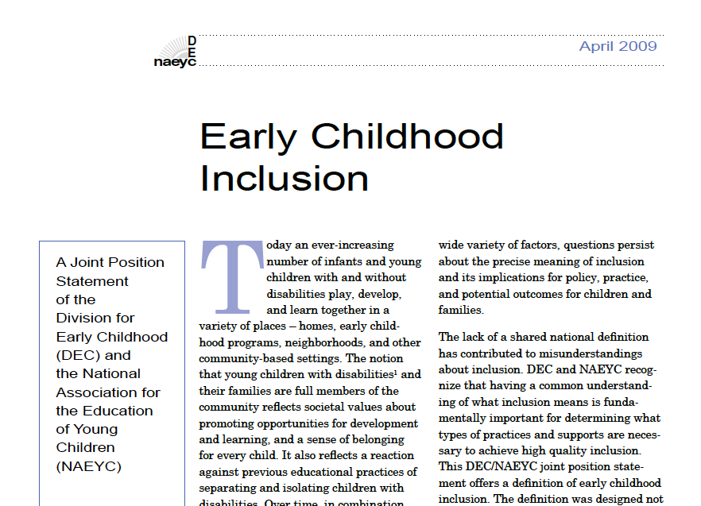
Early Childhood Inclusion:
The Profession FACTS

Slide 25
Early Childhood Inclusion:
The Profession FACTS
DEC/NAEYC (2009) joint position statement supports inclusion:
  Access
  Participation
  Supports

Slide 26
DEC/NAEYC Position Statement on Inclusion: Access
Ensure that all children have access to effective learning environments; typical routines, activities, and settings; and general education curricula
Enhanced physical accessibility
Identify and eradicate physical or structural barriers
Offer multiple and varied learning opportunities

Slide 27
DEC/NAEYC Position Statement on Inclusion: Participation
Ensure all children are active, independent participants in their families, classrooms, and communities
Use a range of instructional practices to ensure all children have opportunity to engage, participate, and learn across all domains
Individualized accommodations, modifications, and adaptations to promote active participation and sense of belonging for all children
Driven by the needs of the individual child and his/her family

Slide 28
DEC/NAEYC Position Statement on Inclusion: Supports
Broader, infrastructure level support to administrators, teachers, staff, etc. to provide effective quality programs
Programs ensure that all adults involved have access to:
  Quality professional development, effective ongoing follow-up assistance, and support for collaborative teaming
Effective policies in place that promote and incentivize quality Early Childhood Inclusion

Slide 29
Early Childhood Inclusion:
The Practice FACTS
  In 30 years, the practice of providing special education and related services in regular early childhood settings to preschoolers with disabilities has increased only 7.2% and many young children with disabilities continue to be educated in separate settings.
Notes:
EEB

Slide 30
Early Childhood Inclusion:
The Practice FACTS
  Increased only 7.2%
Barton & Smith, (2015)

Slide 31
Early Childhood Inclusion:
The FACTS
Research is clear: it’s effective
IDEA is clear: it’s preferred
The profession is clear: it’s the right thing to do
Rates of inclusion have not increased by enough; most children with disabilities are not being included.
SCIENCE
LAWS
PROFESSION
PRACTICE
Notes:
REVIEW FACT SHEETS
EEB

Slide 32
The Survey: Inclusion Definition
Preschool Inclusion:
when children (ages 3 - 5) with Individual Education Programs (IEP) receive their special education and related services in settings with at least 50% of peers without IEPs.
Notes:
EEB

Slide 33
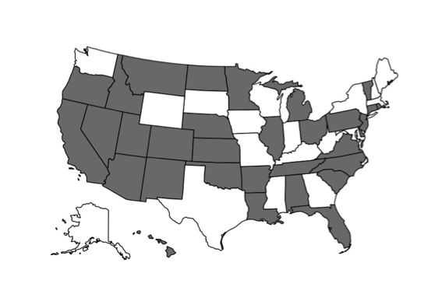
The Survey: Respondents
238 people responded to the survey.
This included representation from 32 states and 1 territory.
Notes:
EEB

Slide 34
The Survey: Roles
Roles | N | %
School District Special Education Preschool Coordinator or Child Find Coordinator | 50 | 21.0%
School District Special Education Director | 49 | 20.6%
School District Early Childhood Administrator | 38 | 16.0%
State Section 619/IDEA Preschool Coordinator | 35 | 14.7%
Head Start Administrator | 24 | 10.1%
ECSE/Sped Teacher/Consultant | 17 | 7.1%
State Special Education Director | 10 | 4.2%
School Principal | 7 | 2.9%
School Psychologist | 3 | 1.3%
Notes:
EEB
2% were others

Slide 35
What are the challenges to Early Childhood Inclusion?
Challenge | N | %
Attitudes & Beliefs | 71 | 29.8%
Fiscal & contracting | 45 | 18.9%
Approval of non-public school setting | 37 | 15.5%
Transportation | 35 | 14.7%
Differing Curricula | 35 | 14.7%
Personnel | 27 | 11.3%
Program Quality | 25 | 10.5%
Conflicting policies | 23 | 9.7%
Notes:
Barbara

Slide 36
Comparison to 1993 Survey
Challenge | 1993 Rank | 2014 Rank
Attitudes & Beliefs | 2 | 1
Fiscal & contracting | 3 | 2
Approval of non-public school setting | 5 | 3
Transportation | 7 | 4
Differing Curricula | 8 | 5
Personnel | 1 | 6
Program Quality | 4 | 7
Conflicting policies | 6 | 8
Notes:
Barbara

Slide 37
Comparison to 1993 Survey
Challenge | 1993 Rank | 2014 Rank
Attitudes & Beliefs | 2 | 1
Fiscal & contracting | 3 | 2
Approval of non-public school setting | 5 | 3
Transportation | 7 | 4
Differing Curricula | 8 | 5
Personnel | 1 | 6
Program Quality | 4 | 7
Conflicting policies | 6 | 8
Notes:
Barbara

Slide 38


Solutions and Strategies that support Early Childhood Inclusion

Slide 39
Attitude & Belief Solutions/Strategies
Two categories
Collaboration across regular EC and ECSE personnel; between district and community programs
Building awareness/support
Notes:
Our attitudes result from some very complex forces, but they are learned. And what is learned can be unlearned and changed.
Others we found by trying out an idea and being rewarded or punished for doing so. This is often the case with beliefs about social issues.
Cognitive approaches rely upon changing the way people think about an attitude object. Most often, this is done by using information or persuasive communication to introduce conflict, or dissonance, between the old attitude and the new one.
Behavioral approaches rely on reinforcements and punishments. Because we are inclined to repeat those behaviors that are rewarded, this approach calls for the conscious reward of positive attitudes as they are expressed. The reward increases the chance the attitude will be expressed again, and, ultimately, incorporated into the individual’s belief system.
Social approaches rely on our tendency to copy the beliefs and behaviors of other people we admire. People, especially children, exposed to attitudes expressed by attractive role models tend to adopt those attitudes as their own. And, if they are rewarded for doing so, they will sustain them over time.

Slide 40
Collaboration
Establish interagency inclusion team
Provide joint PD for district EC, ECSE, and community personnel
Ensure support to community programs for ECSE and behavior support
Establish transdisciplinary teams to build support for inclusive settings
Build culture of collaborative problem solving

Slide 41
Build Awareness & Support
Provide awareness materials and opportunities for local administrators, families, providers
Provide easy to read materials on benefits/laws for Early Childhood Inclusion
Provide models of high quality inclusion for people to visit
Provide opportunities for practitioners, administrators and families to explore concerns, benefits and possible solutions
Arrange meetings with teachers, parents and administrators involved in successful inclusion

Slide 42
Policy Solutions & Strategies
Create MOU’s and contracts with community programs that address quality
Require co-teaching (EC & ECSE) practica for certification
Provide training and coaching to community programs as well as itinerate ECSE services
Provide state training and T/A to district and community EC programs
Notes:
BJS

Slide 43
Policy Solutions & Strategies
Make public school programs inclusive:
  create tuition based access to district EC programs for nondisabled children from community
  make district pre-k, Title I programs inclusive
Reimburse parents for transportation
Create a state-level inclusion team for “barrier busting” that responds to local concerns
State dissemination to districts of creative ways to provide inclusion; examples; incentives
Notes:
BJS

Slide 44
Resource Solutions & Strategies
Braiding funding streams (pre-k, IDEA, Title I, etc.)
Collaboration
Redistribution (itinerate/consultative vs. segregated)
Public awareness of the benefits=$$
Literature indicates inclusive services do not cost more than segregated
Notes:
BJS

Slide 45
Evidence Based Practices for Successful Inclusion
Notes:
Megan

Slide 46
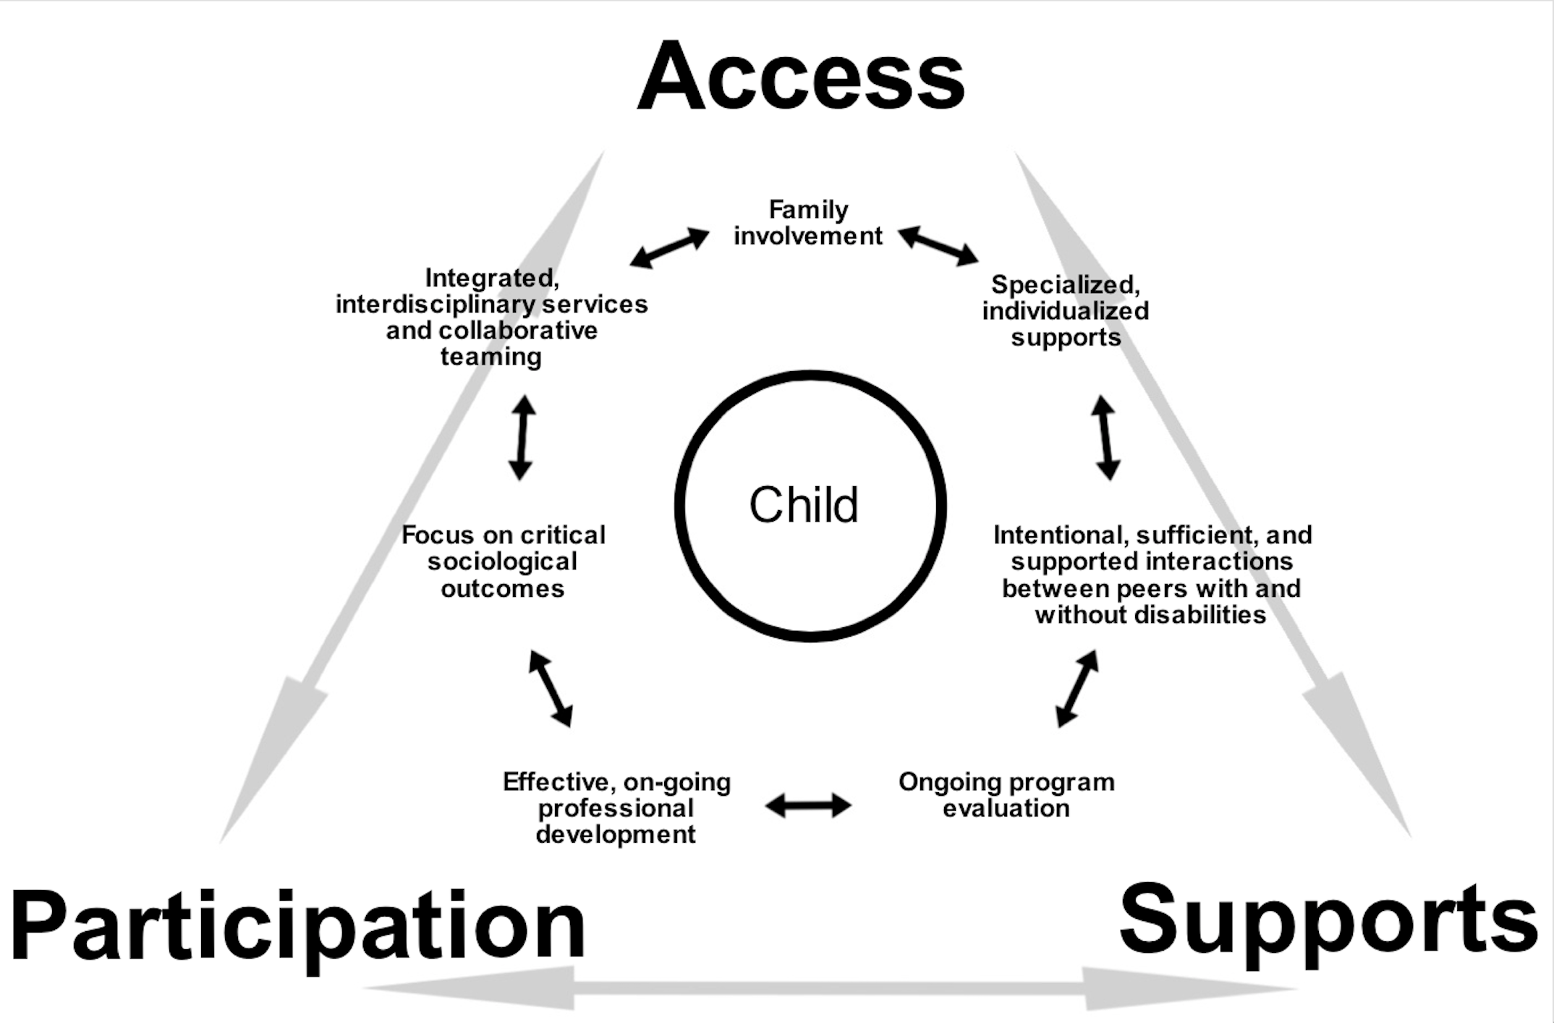

Slide 47
Use DEC Recommended Practices
Provide guidance to practitioners about effective ways to promote the development of young children with or at risk for disabilities
Translate research into practice and emphasize the practices that are known to be effective and that produce better outcomes for children and families
Should be used within developmentally and culturally responsive frameworks
Notes:
Megan

Slide 48
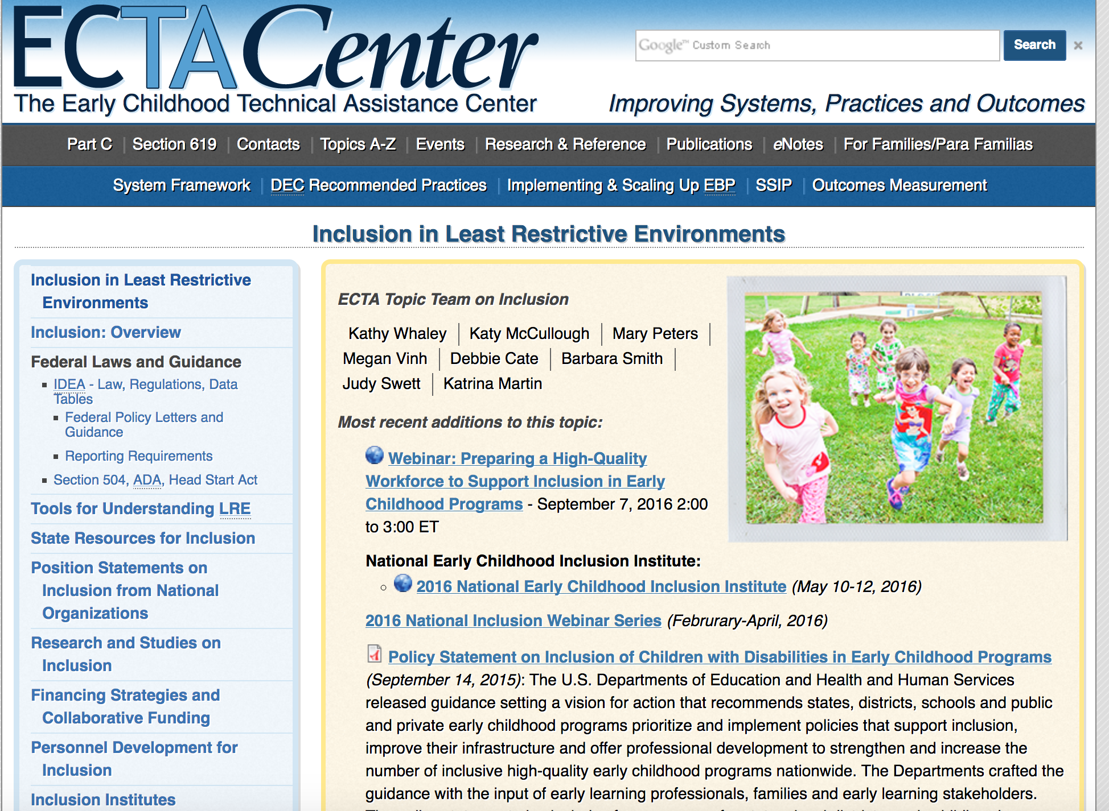
Resources

Slide 49

Resources

Slide 50

Resources

Slide 51
Share what is happening from your agency or position that is currently or could increase high quality inclusion of young children.
Share something you heard today that raises questions or resonates with you.
Notes:
Optional Chat---
Or we just --
Offer the google doc to everyone to add their efforts? Or just email us so we can add to the doc– gives everyone a stake in the game– beyond the summit what is happening….

Slide 52
Poll- Select up to 3 state recommendations that have the most potential for IL and should be prioritized?
Create a State-Level Interagency Task Force and Plan for Inclusion (vision)
Set Goals and Track Data
Review and Modify Resource Allocations
Ensure Quality Rating Frameworks are Inclusive
Strengthen Accountability and Build Incentive Structures.
Build a Coordinated Early Childhood Professional Development (PD) System
Implement Statewide Supports for Children’s Social-Emotional and Behavioral Health
Raise Public Awareness

Slide 53

The summit is February 28, 2017
What is your agencies role in policies that support inclusion?
What opportunities do you see from your perspective regarding inclusive policies?
What questions or challenges do you see?
Notes:
Il vision for inclusion- we are hoping for the day shared awareness opportunities and challenges and shared vision with concrete next steps.
Work force
TA Training to support
Models for funding service delivery in community.
Do you need another conversation? Want to learn more before Drop me an email at ann.kremer@eclre.org

Slide 54
Summit Discussion Areas
Strengthening and Supporting a Competent Workforce
Improving Access to Inclusive Early Childhood Settings
Systems Alignment and Collaboration

Slide 55

Do you need more information before the summit?
Drop an email to
Ann.kremer@eclre.org
And we can set up a time to talk.
Notes:
Largest questions
Best take away from today
Do you need another conversation? Want to learn more before Drop me an email at ann.kremer@eclre.org

Slide 56

Contact Information
Ann Kremer
  ann.kremer@eclre.org
  815-356-8310
Erin Barton
erin.e.barton@vanderbilt.edu
Thanks!

